Slide 1
Convolutional Neural Networks(CNN) Machine Learning: Theory and Application Nikita&Ogul

Slide 2
What is CNN and Why should I use it?
Cars recognizing road signs, Instagram recognizes your friends, face recognition apps. Magic? No, CNN.
CNN is another type of neural network like a multi-layer perceptron.
CNNs are able to extract the features of an image, which an algorithm like a multi-layer perceptron (MLP) or a recursive neural network (RNN) does not have the ability to do!
Convolution comes from the Latin convolvere, “to convolve” means to roll together. Convolution is a mathematical operation on two functions (f and g) to construct a third function that represents how the shape of one is modified by the other.

Slide 3
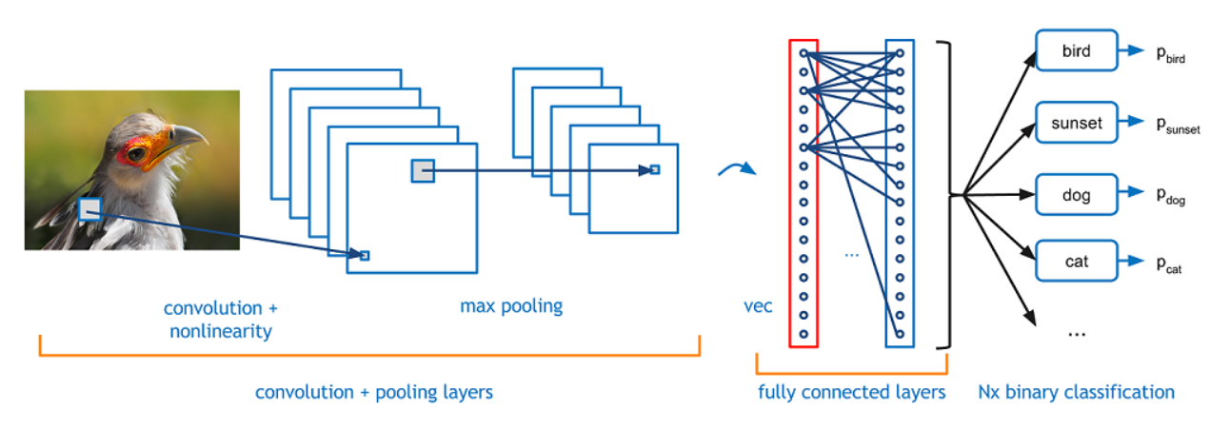
A CNN architecture

Slide 4

Social media is all about CNN. Platforms that are heavily dependent on image processing are using alot of CNN. We are not going to cover video processing although for a quick information; to deal with video processing, there is Tube Convolutional Networks(Tube-CNN)

Slide 5
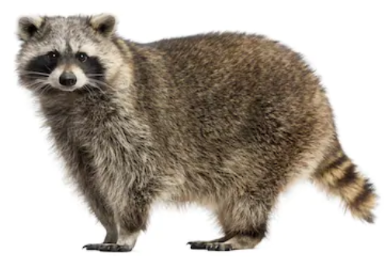
How do we do it?
Image classification is the task of taking an input image and outputting a class (a cat, dog, etc) or a probability of classes that best describes the image. For humans, this task of recognition is one of the first skills we learn from the moment we are born and is one that comes naturally and effortlessly as adults.
A question, How do you think your brain classifies objects or images so fast and accurate?
When the eyes are open, visual information flows from the retina through
the optic nerve and into the brain, which assembles this raw
information into objects and scenes.

Slide 6
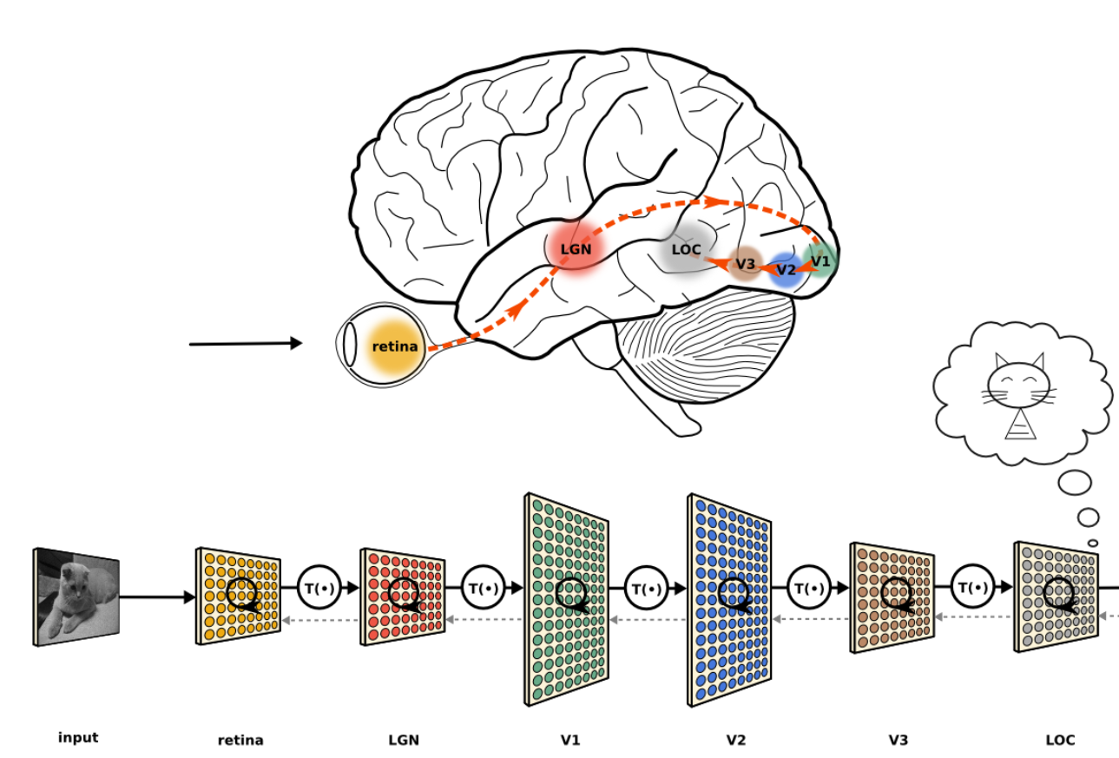

Slide 7
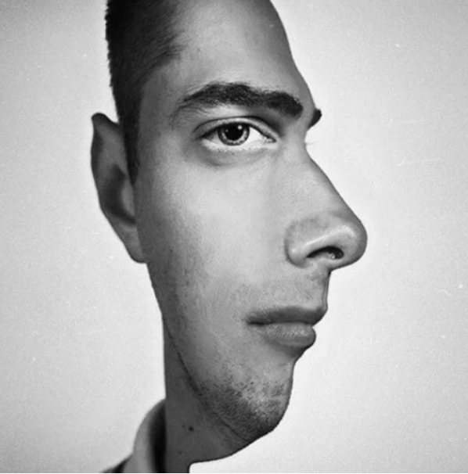
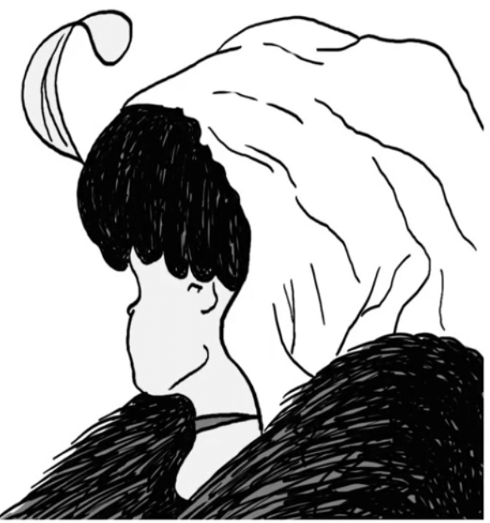
Whenever we see an image, the brain looks for the features in the image to classify that image. We categorize things by recognizing the features. Classify two images from this picture below:

Slide 8
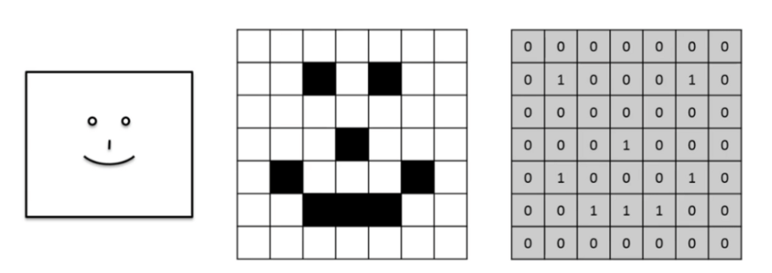
How do computers see?
A very important information: an image is a matrix of pixels. If there is a black and white image, then we will get a 2D array. While, if we passed a colored image, then we will get a 3D array, which means it has an extra parameter for depth which is RGB(Red,Green,Blue) channel as shown below. The pixel value lies between 0 and 255, and images are stored in bytes (0 to 255).

Slide 9
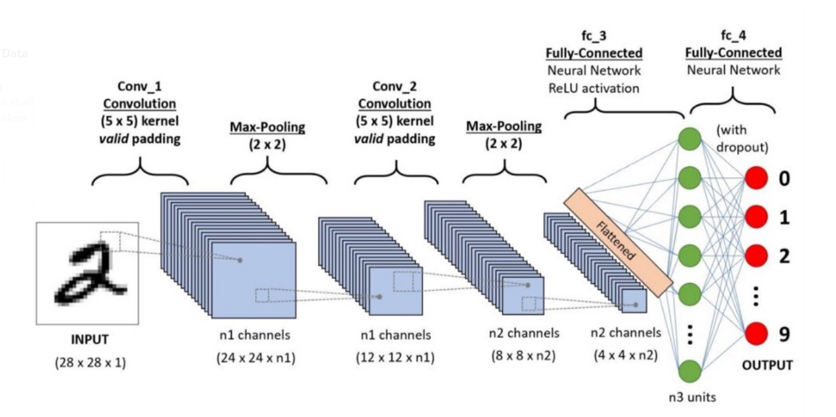
CNN is a Deep Learning algorithm which can take in an input image, assign importance (learnable weights and biases) to various aspects/objects in the image and be able to differentiate one from the other. The pre-processing required in a CNN is much lower as compared to other classification algorithms

Slide 10
Why CNN instead of Feed-Forward Neural Networks?
A ConvNet is able to successfully capture the Spatial and Temporal dependencies in an image through the application of relevant filters.
Spatial dependence is the spatial relationship of variable values (for themes defined over space, such as rainfall) or locations (for themes defined as objects, such as cities). Spatial dependence is measured as the existence of statistical dependence in a collection of random variables.
In the definition of a temporal functional dependency, a temporal relation is perceived as a collection of snapshot relations.
Think of this as independence/dependence.

Slide 11
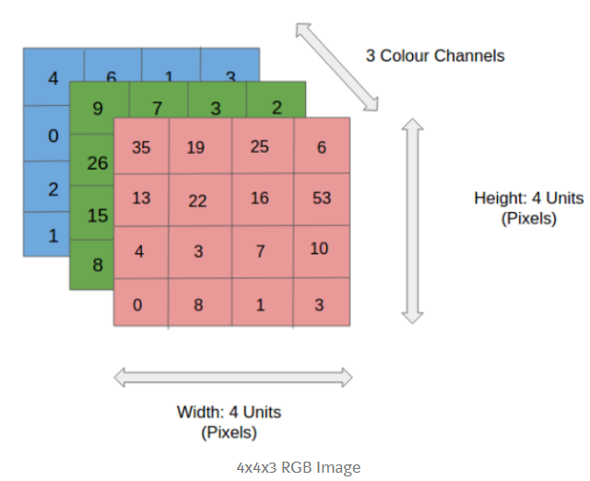
This is a RGB image which has been separated by its three color planes — Red, Green, and Blue. There are a number of such color spaces in which images exist — Grayscale, RGB, HSV, CMYK or more. Imagine you have 8K (7680×4320). The role of the CNN is to reduce the images into a form which is easier to process, without losing features which are critical for getting a good prediction.

Slide 12
Image Dimensions = 5 (Height) x 5 (Breadth) x 1 (Number of channels, eg. RGB) Convoluting a 5x5x1 image with a 3x3x1 kernel to get a 3x3x1 convolved feature. Kernel/Filter, K, represented in the color yellow. We have selected K as a 3x3x1 matrix.

Slide 13
The filter moves to the right with a certain Stride Value till it parses the complete width. Moving on, it hops down to the beginning (left) of the image with the same Stride Value and repeats the process until the entire image is traversed.

Slide 14
The objective of the Convolution Operation is to extract the high-level features such as edges, from the input image.
The bias neuron is a special neuron added to each layer in the neural network, which simply stores the value of 1. This makes it possible to move or “translate” the activation function left or right on the graph.
Stride is the number of pixels shifts over the input matrix. When the stride is 1 then we move the filters to 1 pixel at a time. When the stride is 2 then we move the filters to 2 pixels at a time
The objective of the Convolution Operation is to extract the high-level features such as edges, from the input image.

Slide 15
There are two types of results to the operation — one in which the convolved feature is reduced in dimensionality as compared to the input, and the other in which the dimensionality is either increased or remains the same. This is done by applying Valid Padding in case of the former, or Same Padding in the case of the latter.
The following link will help you to understand what is happening and how Padding and Stride Length work together.
https://github.com/vdumoulin/conv_arithmetic

Slide 16
Similar to the Convolutional Layer, the Pooling layer is responsible for reducing the spatial size of the Convolved Feature. This is to decrease the computational power required to process the data through dimensionality reduction.
Below: 3x3 pooling over 5x5 convolved feature

Slide 17
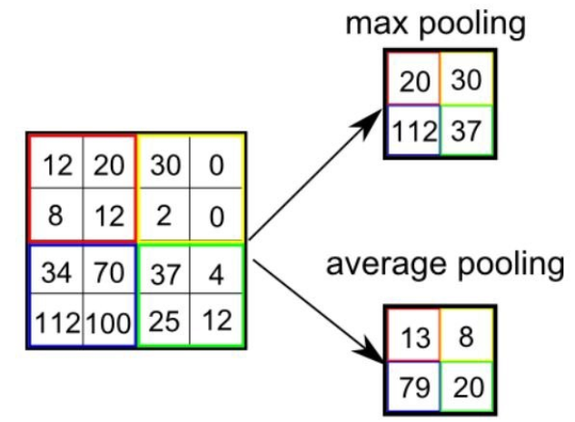
There are two types of Pooling: Max Pooling and Average Pooling. Max Pooling returns the maximum value from the portion of the image covered by the Kernel. On the other hand, Average Pooling returns the average of all the values from the portion of the image covered by the Kernel.

Slide 18
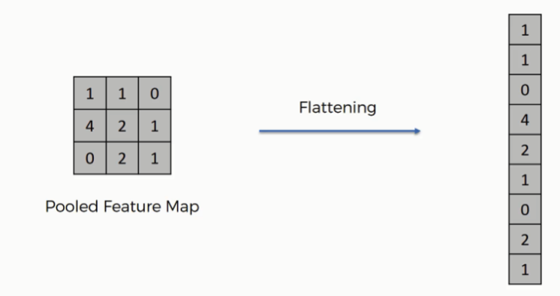
Flattening is turning our multi-dimensional input tensor input a 1-D input tensor. For example, say the final convolutional layer outputs a (28, 28, 3) tensor. Flattening this output would give the next layer an input of (2352, 1). 2352 comes from multiplying 28 X 28 X 3, which are the dimensions of the previous output tensor.

Slide 19
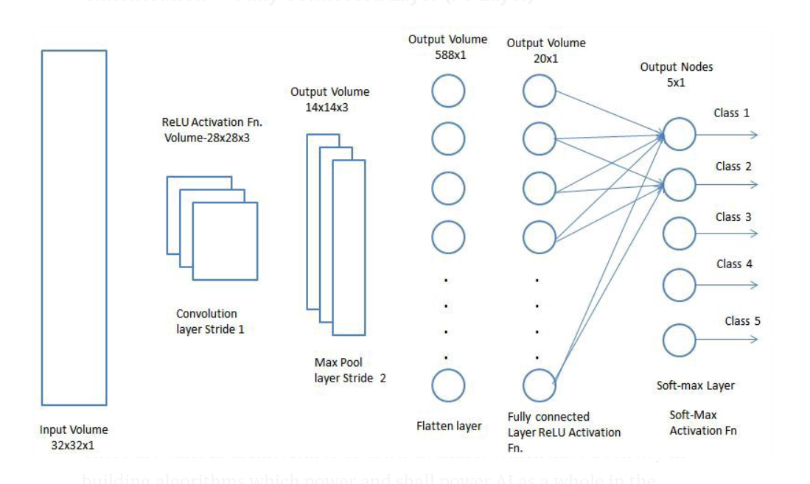
After going through the above process, we have successfully enabled the model to understand the features. Moving on, we are going to flatten the final output and feed it to a regular Neural Network for classification purposes.

Slide 20
After the input is flattened, it passes through the dense layer. The dense layer performs it’s work, and then right before we move to the final dense layer, we have to perform dropout. Dropping out neurons is randomly setting some of the output neurons to zero, just to speed up the training and backpropagation process, and to prevent overfitting our network.

Slide 21
Choose a loss function is a way of calculating how accurate the data is. The goal of any optimization problem (any neural network) is to minimize the cost function.
There are various types of loss functions. In CNN’s you may use many of them. Cross-Entropy is popular choice. Cross-Entropy calculates the difference between the probability distribution (can be a vector, matrix, tensor, etc.) of the network’s output and the probability distribution of the labels.
Optimization in machine learning is finding the best weights/biases which will return the lowest cost (loss). An optimizer is an algorithm that does exactly this. Example: ADAM(adaptive learning rate optimization)

Slide 22
Summary
A CNN is a type of deep neural network often used to deal with image data and for complex classification problems.
The architecture of a CNN involves different types of layers, that include: Convolution, Max Pooling, Dense, Dropout.
The Convolution layers extract feature(s) from the image by multiplying a filter matrix with the image tensor, creating a filtered layer of the image.
Afterward, the filtered layer is pooled (the size of the filtered layer is reduced). This is done through Max Pooling.
After the image passes through several convolution + max-pooling layers, it gets flattened and goes into the Dense layer.
After the dense layer does it’s work, several (RANDOM) neurons are dropped to prevent overfitting.
You can use the optimizers and loss functions to train your model.

Slide 23
Now, we converted our input image into a suitable form for our Multi-Level Perceptron, we will flatten the image(explained) into a column vector. The flattened output is fed to a feed-forward NN and backpropagation applied to every iteration of training(This step is up to you). Over a series of epochs(and alot of computation power), the model is able to distinguish between dominating and certain features in images and classify them.
Check those Nets and prepare a small document about what are their differences. (Optional, If you have extra time)
LeNet
AlexNet ( try in MATLAB)
VGGNet
GoogLeNet
ResNet
ZFNet

